Slide 1
Causal Loop Diagrams – part 1
Visualising connections between parts of systems
Freya Ivy Palmer, Avanthika Kamath, Imali Manikarachchige, Craig Hutton
Full resource, see: https://www.ncrm.ac.uk/resources/online/all/?id=20845
Notes:
Hi there,
SO this tutorial is about causal loop diagrams visualising connections between parts of a system– which are a qualitative tool to map a system

Slide 2
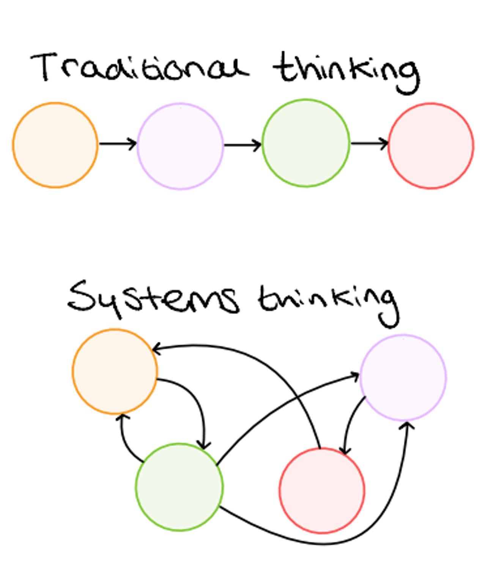
What are Causal Loop Diagrams (CLDs)?
Systems thinking approach
Understand causalities between variables and how a system acts
Visualisation tool to deal with complexity
Notes:
So first off what are causal loop diagrams often a qualitative method – they are a tool that goes hand in hand with systems thinking – where you consider the connections between things that you may ordinarily assume are linear.
The help to understand a system by understanding the connections between variables and so infer how a system acts. through mapping the connections it allows for interdependcies to be identified and helps to visualise complexity

Slide 3
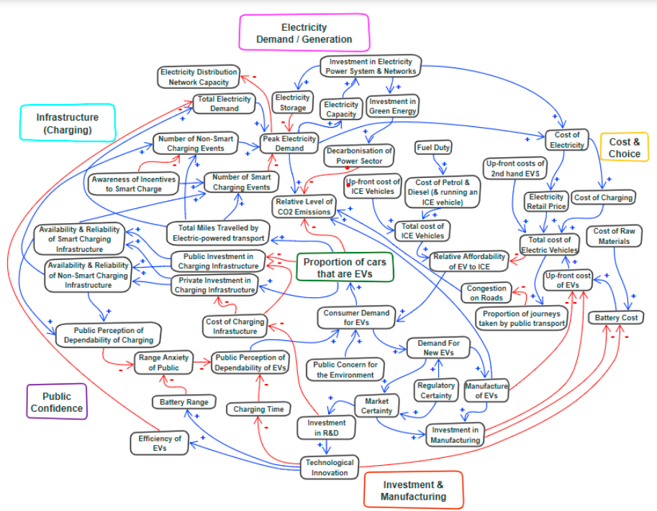
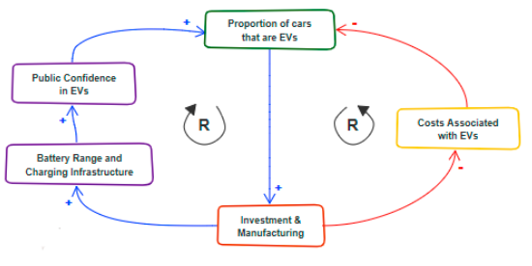
Why do CLDs?
Holistic deeper understanding
Discover research gaps
Identify root causes of a problem
Policy outputs
Notes:
Understand causalities and so the system in a deeper way e.g Net zero with EVs
Can use in multiple ways such as a literature review tool to discover evidence and research gaps – data for this can be qual or quant
Can help identify root cause of problems and impediments to success such as finding negative reinforcing or balancing feedback loop, trade-offs, and unintended consequences.
Can help with guiding policy changes and support theories of change
Although this CLD looks complex , ti can be simplified and then show the nature of the feedback loops in more detail. For this example there are two reinforcing loops – as investment increases the cost decreases and so the number of EVs increases… Ans as investment increases, battery range increases, public confidence increases and so does the number of EVs

Slide 4
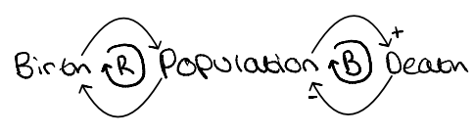
Simple CLD
The population of X is dependent on births and deaths
As births increase population increases
As population increases births increase
  Reinforcing loop
As population increases deaths increase
As death increases population decreases
  Balancing loop
Notes:
CLDs can be as simple (or complex) as you wish
Here’s a simple population based CLDs where both reinforcing and balancing loops are present.
The population will only stabilise when the reinforcing loop is equivalent to the balancing (?)

Slide 5



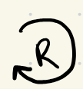

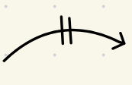
CLD notation
Symbol | Meaning
No symbol | Variable – a variable that has influence on another variable
 | Causal link - relationship
 | Positive causality – proportional relationship
 | Negative causality – indirectly proportional relationship
 | Reinforcing loop – compounded change
 | Balancing loop – change becomes stabilised
 | Time delay– causality occurs after hitting a threshold
Notes:
Exp growth
Growth which then Plateus

Slide 6
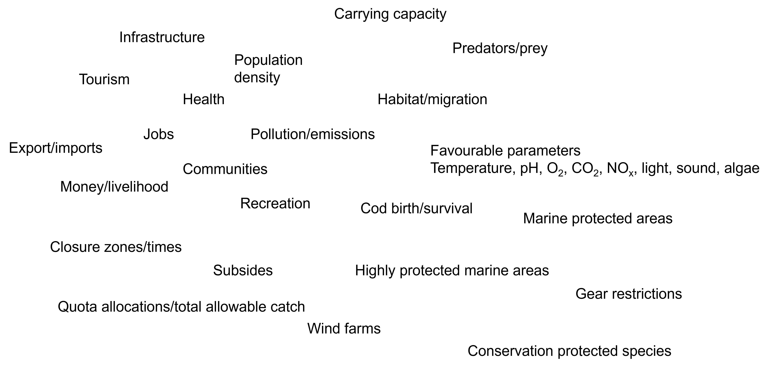
Steps to building a CLD
Step 2 – Split into themes
Step 1 – Mind dump
Nutrition
Notes:
Step 1 = Mind dump list any variables that you believe may be relevant to the system you wish to map.
For this we are looking at the sustainability of cod fisheries
Step 2 = split variables into key themes
When considering the cod fishery’s sustainability you can break it down into three pillars, the environmental, economic, and social. As well as the regulations that act on these. So this step categorises each variable into relevant themes. Note some may be in more than one theme – that’s fine!

Slide 7
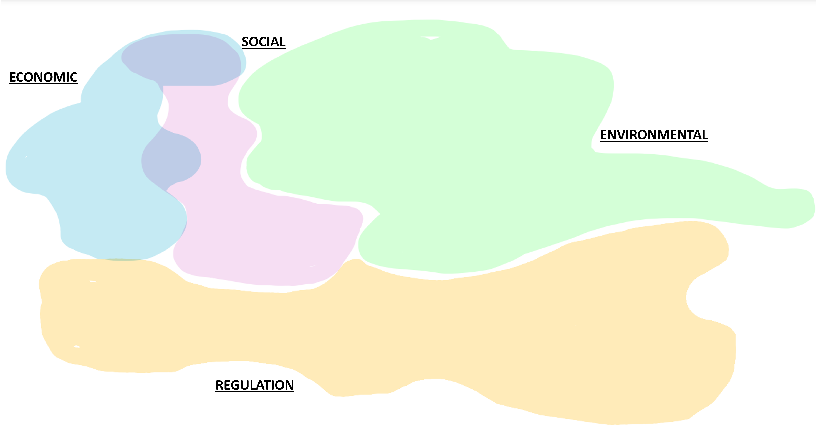
Steps to building a CLD
Step 1 – Mind dump
Step 2 – Split into themes
Nutrition
Notes:
Step 1 = Mind dump list any variables that you believe may be relevant to the system you wish to map.
For this we are looking at the sustainability of cod fisheries
Step 2 = split variables into key themes
When considering the cod fishery’s sustainability you can break it down into three pillars, the environmental, economic, and social. As well as the regulations that act on these. So this step categorises each variable into relevant themes. Note some may be in more than one theme – that’s fine!

Slide 8
Steps to building a CLD
Step 3 – Research Question/aims
Determine the research question and aims to achieve from building the CLD
Think about what is the context of the system
Set the boundaries of the system
Select variables that answer the research question – variables that do not do this are outside the boundaries of the system
Notes:
Whats the research Q/aim
Relate the research Q’s with themes
S
The research Q we are addressing is what impacts cod fish populations – focusing of a fishery perspective

Slide 9
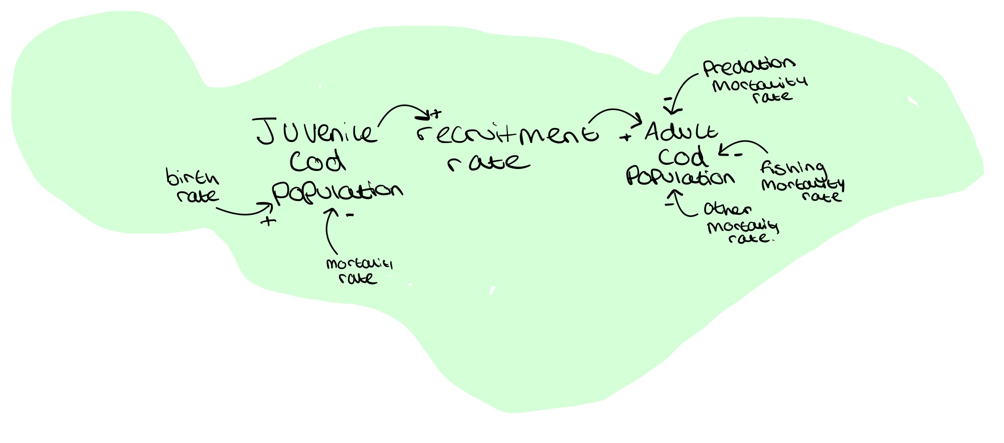
Steps to building a CLD
Step 4 – Start drawing CLD iteratively
Notes:
Causal relations between
Factors/posit/loops are changed throughout ITERATIVE
This is the environmental ecological component of cod fish
This is the flow of life for cod populations. Births lead to juvenile cod. Those juvenile cod can either die of natural causes (mort rate) or grow to become adult cod. Once adult cod they then eventually die either naturally, by predators, or by fishing

Slide 10
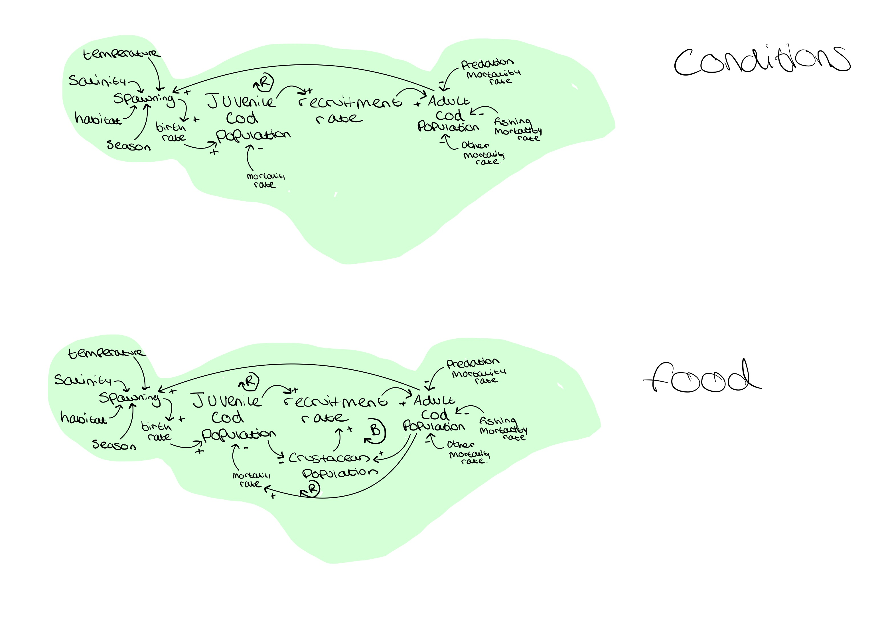
Steps to building a CLD
Step 4 – Start drawing CLD iteratively
Notes:
Causal relations between
Factors/posit/loops are changed throughout ITERATIVE
This is the variables that influence birth rate, mainly spawning conditions, Also as the number of adult cod increases this increases the amount of spawning hence the first reinforcing loop – EXPLAIN what reinforcing loop means again

Slide 11

Steps to building a CLD
Step 4 – Start drawing CLD iteratively
Notes:
Causal relations between
Factors/posit/loops are changed throughout ITERATIVE
Other things that impact the populations and the amount of juvenile cod growin to adult cod is food availability. Both juv and adult cod eat a lot of crustaceans. Notice the balancing loop as if the number of cod increases then the crustacean population would decrease. Explain what balancing loop is again
Also adult cod eat juvenile cod which adds the mortality of juv cod

Slide 12
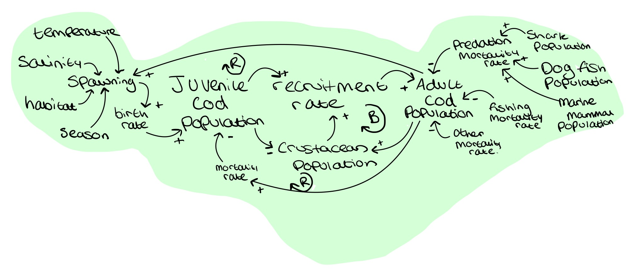
Steps to building a CLD
Step 4 – Start drawing CLD iteratively
Notes:
Causal relations between
Factors/posit/loops are changed throughout ITERATIVE
This adds predation. Variables that will impact the predation mortality are the populations of said predetors. For cod this is dogfish, marine mammals such as seals and sharks

Slide 13
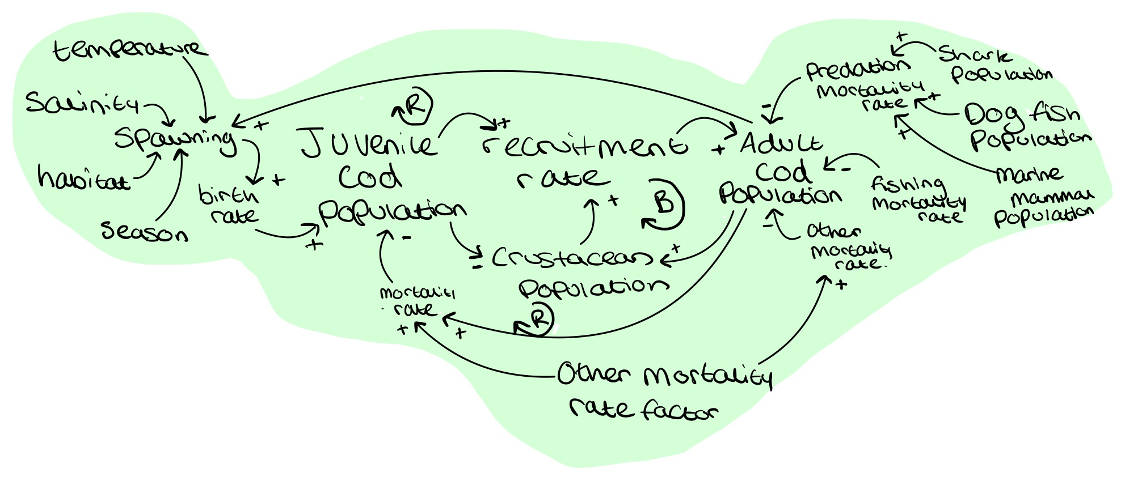
Steps to building a CLD
Step 4 – Start drawing CLD iteratively
Notes:
Causal relations between
Factors/posit/loops are changed throughout ITERATIVE
This simply just adds in the other mortality factor which leads to cod deaths – this would just be natural deaths such as old age

Slide 14
www.ncrm.ac.uk

